Slide 1


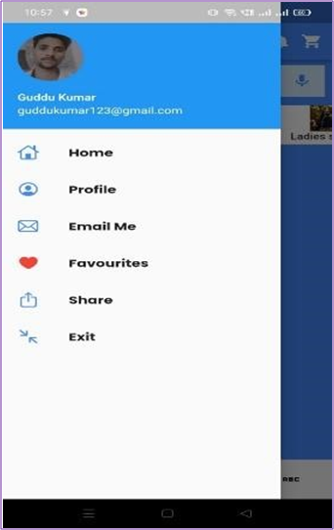
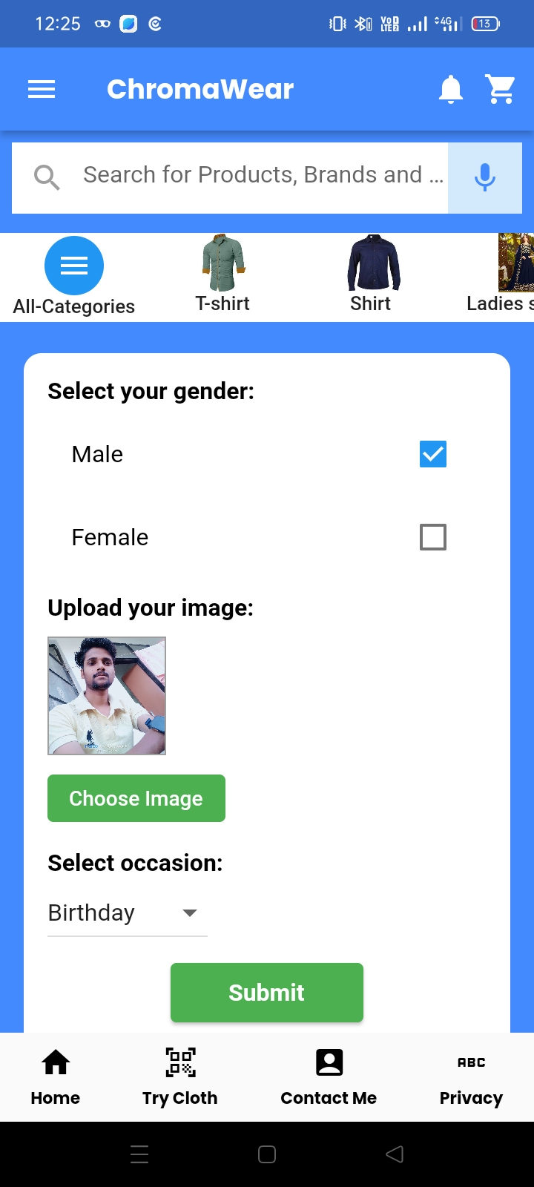
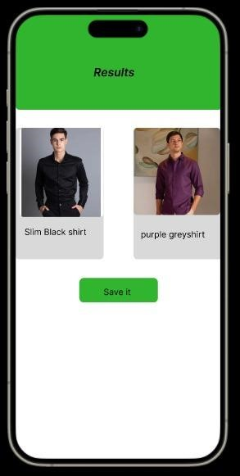
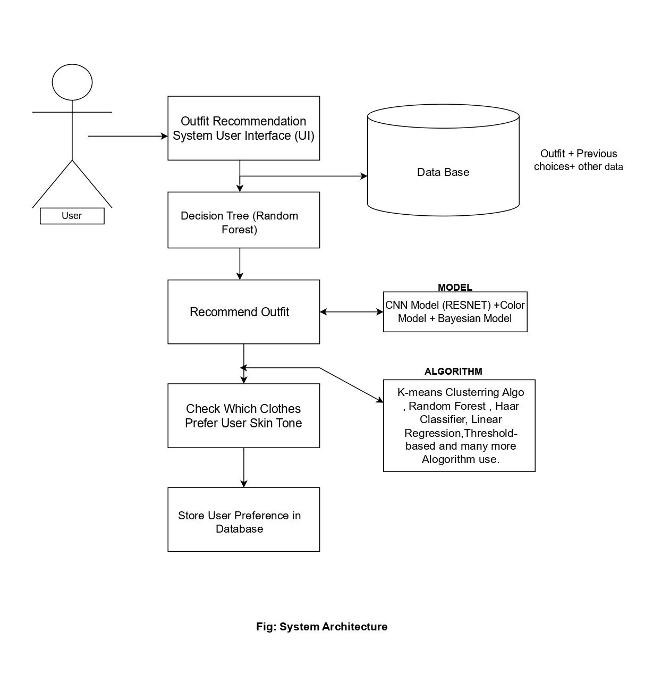
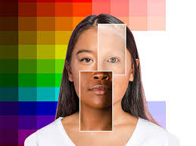
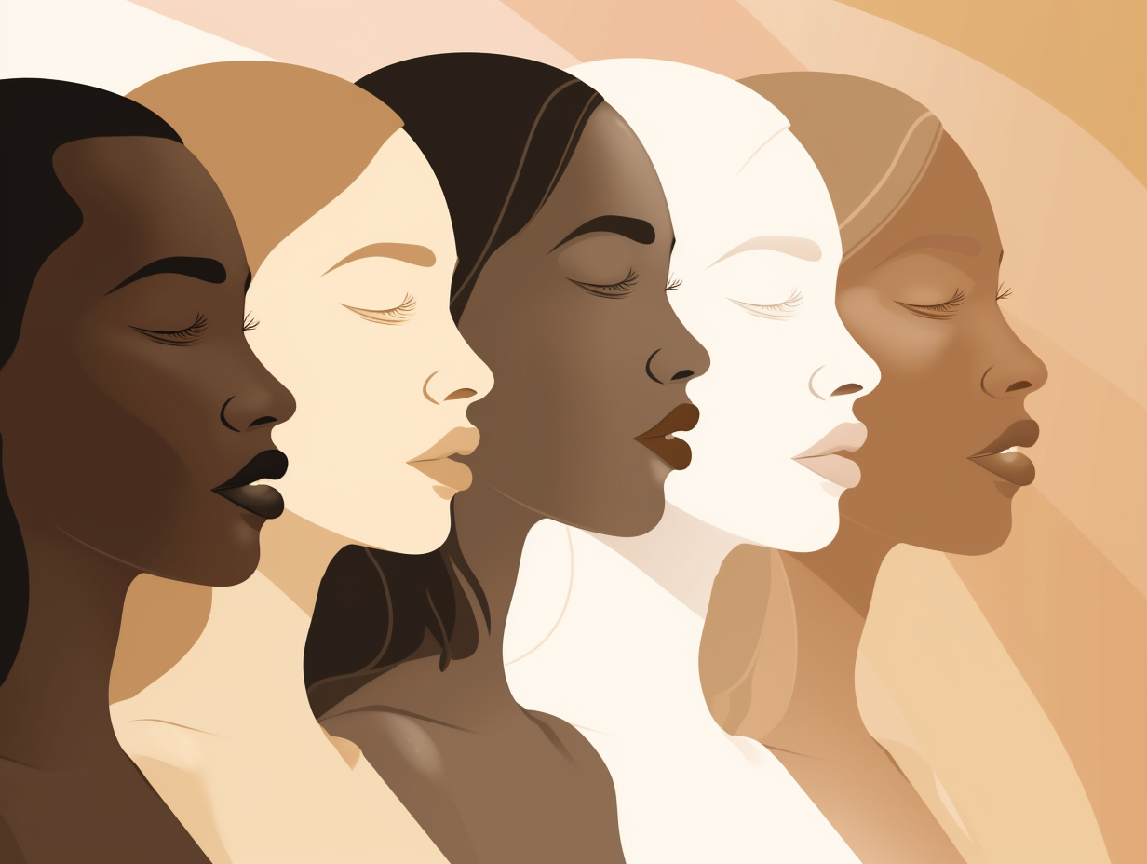


ABSTRACT
OBJECTIVE
This research work presents a personalized fashion design recommender system with artificial intelligence support to improve the fashion choices of people with different skin tones.
Its goal is to assist users in selecting outfits that complement their complexion, ultimately saving time and enhancing confidence in fashion choices
METHODOLOGY
INTRODUCTION
The proposed system has various operations like skin tone detection using K-means algorithm and recommendation of clothes using decision tree.
Through augmented reality and machine learning, the skin tonner system analyses skin tone and body shape to generate abstract digital overlays of clothing for users to interact with in real-time.
The system aims to improve fashion choices for people with different skin tones by providing personalized fashion recommendations based on skin tone analysis, color palettes, fabric textures, and clothing styles. the development of a personalized fashion design recommender system leveraging artificial intelligence (ai) and machine learning techniques
FUTURE WORK
Future work includes expanding the system to recommend complete outfits based on color correlation and other factors.
It uses advanced AI algorithms to help people make informed fashion decisions, boosting their self-expression and confidence.
Exploring skin toner-based systems for virtual try-on of clothes offers exciting avenues for future research in fashion tech, enhancing user experience and revolutionizing online shopping.
RESULTS/FINDINGS
Sign-up got easier, more people joined because forms were simpler and prompts encouraged sticking around.
Home screen is where users check clothes using skin tone system due to clear displays and easy browsing.
Result page impressed users with accurate fit and colors, boosting trust and reducing returns.
Profile page's customization options made users happy, encouraging them to return and try new products. Feedback on AI fashion recommendations is positive, with suggestions for improvement including adding real-time trends and more diverse outfit suggestions
REFERENCES
CONCLUSION
P., Prof & S., Bagul & K., Pardeshi & V., Paymode & P, Madhawai.: Improving Foundation Shade Recommendations using Skin Tone Recognition. International Journal of Advanced Research in Science, Communication and Technology. 668-676. 10.48175/IJARSCT-14290 (2023).
Ziccardi, Giovanni.: Wearable Technologies and Smart Clothes in the Fashion Business: Some Issues Concerning Cybersecurity and Data Protection. Laws. 9. 12.10.3390/laws9020012 (2020).
P. S. C. B. S. Kolkur, D. Kalbande, and J. Jatakia.: Human skin detection using rgb, hsv and ycbcr color models. February (2016).
Garude, Digant & Khopkar, Anushree & Dhake, Monali & Laghane, Shivani & Maktum, Tabassum.: Skin-Tone and Occasion Oriented Outfit Recommendation System. SSRN Electronic Journal. 10.2139/ssrn.3368058 (2019).
Kolkur, S. & Kalbande, Dhananjay & Shimpi, P. & Bapat, C. & Jatakia, Janvi.: Human Skin Detection Using RGB, HSV and YCbCr Color Models. 10.2991/iccasp-16.2017.51 (2017).
Patil, Shankar & Bhanage, Simran & Shali, Zitin.: Automatic Suggestion of Outfits using Image Processing. 6 (2019).
The proposed AI-assisted personalized fashion design recommender system aims to address the challenges of inclusivity and diversity in the fashion industry.
The system utilizes cutting-edge AI algorithms to provide personalized fashion recommendations based on skin tone, color palettes, fabric textures, and clothing styles.

